Slide 1
期中專題
報告者：許清彰

Slide 2
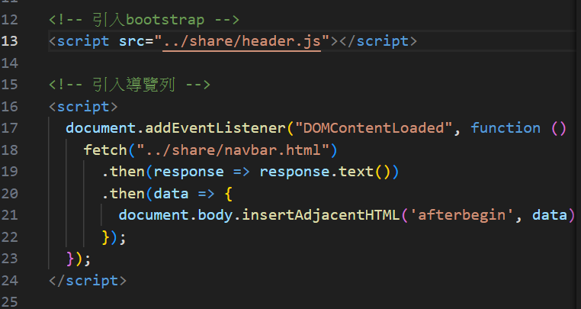
設計-重用
把重複使用到的功能拉出來寫成新的檔案，增加程式可維護性與可讀性。

Slide 3
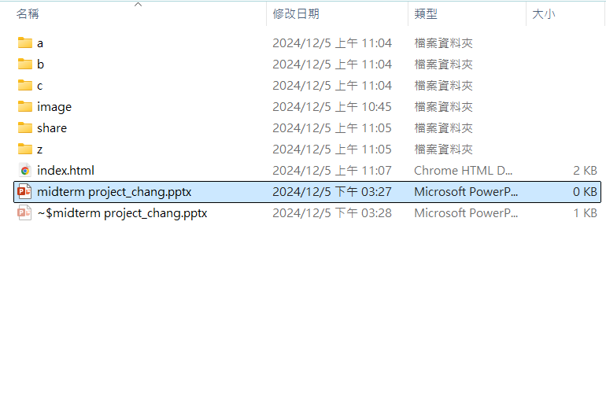
對不同功能分類，並將重複使用的功能獨立出來。

Slide 4
12/10 (二) 首頁(金句 + 圖片動畫)

Slide 5
Soft Colors UI Design for Agencies
Here is where your presentation begins

Slide 6
01
About us
You can describe the topic of the section here

Slide 7
About us
This can be the part of the presentation where you can introduce your company or agency. Keep it short and go straight to the point. Your audience will appreciate it
Meet us

Slide 8
Thanks!
Does anyone have any questions?
addyouremail@freepik.com
+91 620 421 838
yourwebsite.com
Please keep this slide for attribution

